Slide 2
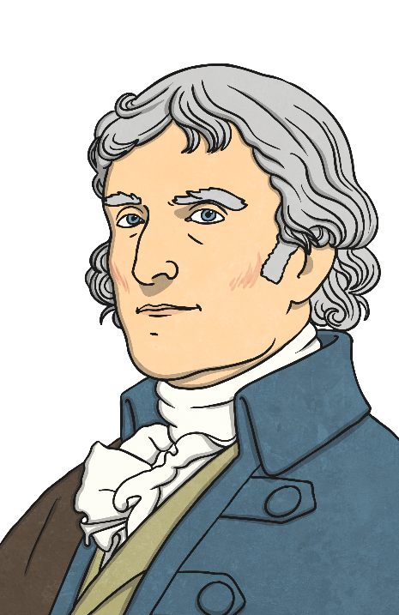
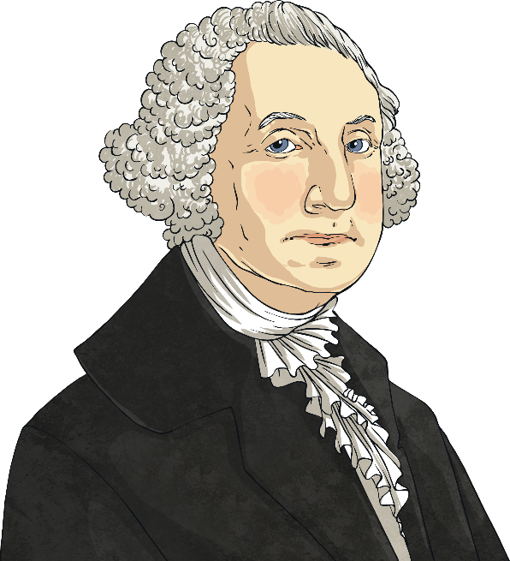
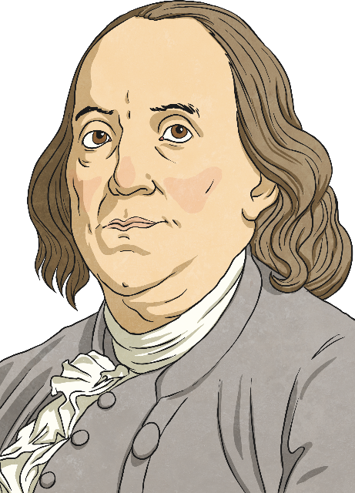
How Well Do You Know…
Thomas Jefferson
George Washington
Benjamin Franklin
Play!

Slide 3
Who Am I?
I was an amateur architect. I designed Monticello, submitted designs for the White House, and proposed designs for the Capital of Virginia in Richmond.
Thomas Jefferson
George Washington
Benjamin Franklin

Slide 4
Thomas Jefferson
next

Slide 5
Who Am I?
I invented a wood stove, swim fins, bifocals, a glass harmonica, watertight bulkheads for ships, the lightning rod, and an odometer.
Thomas Jefferson
George Washington
Benjamin Franklin

Slide 6
Benjamin Franklin
next

Slide 7
Who Am I?
My last will and testament stated that my slaves would be freed upon my death.
Thomas Jefferson
George Washington
Benjamin Franklin

Slide 8
George Washington
next

Slide 9
Who Am I?
You might recognize me from the one dollar bill.
Thomas Jefferson
George Washington
Benjamin Franklin

Slide 10
George Washington
next

Slide 11
Who Am I?
I was the third president of the United States.
Thomas Jefferson
George Washington
Benjamin Franklin

Slide 12
Thomas Jefferson
next

Slide 13
Who Am I?
I was the only person unanimously elected president by the electoral college.
Thomas Jefferson
George Washington
Benjamin Franklin

Slide 14
George Washington
next

Slide 15
Who Am I?
When I was president, the Louisiana Territory was purchased from Napoleon.
Thomas Jefferson
George Washington
Benjamin Franklin

Slide 16
Thomas Jefferson
next

Slide 17
Who Am I?
I suggested the idea of the first subscription library. Today it is called a public library.
Thomas Jefferson
George Washington
Benjamin Franklin

Slide 18
Benjamin Franklin
next

Slide 19
Who Am I?
I sent Lewis and Clark to explore the West when I was president.
Thomas Jefferson
George Washington
Benjamin Franklin

Slide 20
Thomas Jefferson
next

Slide 21
Who Am I?
I wore dentures and many people knew me for my “wooden” teeth.
Thomas Jefferson
George Washington
Benjamin Franklin

Slide 22
George Washington
next

Slide 23
Who Am I?
I was the first president.
Thomas Jefferson
George Washington
Benjamin Franklin

Slide 24
George Washington
next

Slide 25
Who Am I?
I drafted the Declaration of Independence when I was 33 years old.
Thomas Jefferson
George Washington
Benjamin Franklin

Slide 26
Thomas Jefferson
next

Slide 27
Who Am I?
My newspaper, “The Pennsylvania Gazette,” became very popular and profitable.
Thomas Jefferson
George Washington
Benjamin Franklin

Slide 28
Benjamin Franklin
next

Slide 29
Well Done!
Finished
Play Again?

