Slide 1
Want access?
Go to File > Make a Copy. You’ll have full edit access to your own copy. (And you can delete this slide.)

Slide 2
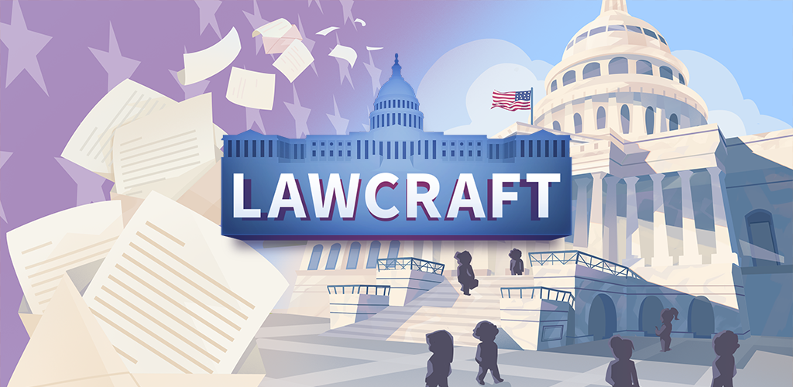

Slide 3
Who represents me?
Pre-Game Activities
Notes:
Before the brainstorm, ask students: What does it mean to represent someone? Explain: We have a representative democracy. Does anyone know what that means? When talking about politics, who represents you?
Have students brainstorm answers to this question. Sample answers: Elected officials at any level (local, state, federal) works!

Slide 4
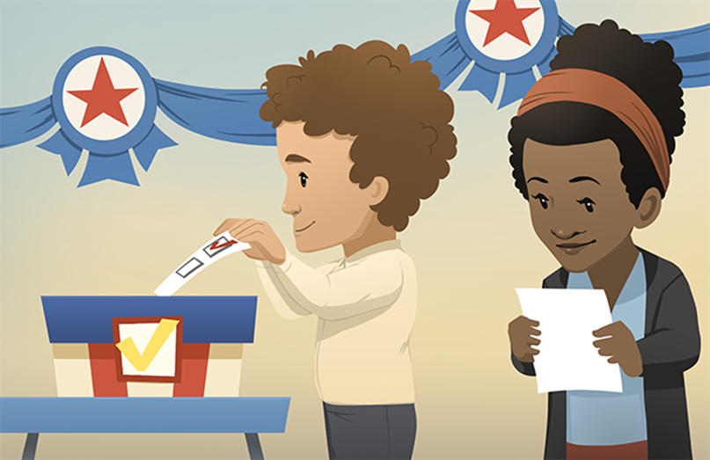
Representation
1. What is it?
The elected officials (people you vote for) in Washington D.C. represent the needs and interests of the people in their districts when they are making laws.
2. Is it easy?
NO! All of our states are very different. Even within a state, different districts have different needs.
For example, in a rural area, they may want more money for farmers. But in an urban district, they may want more money for public transportation. And yet, both may be from the same state!
Notes:
Ask the questions and have students answer in their own words.
Tell students: Think about your state. Ask: What are the different needs across your state? Now compare it to a very different state (Alaska, Texas, etc.). Model obvious differences such as Florida cares about ocean water levels rising and Wisconsin does not. Mention some obvious differences between a few states.
EXTENSION: Have students look up a few issues that are important in their state and chose another state to compare it to. Have them share the results with the class.
ELL: provide the definitions of represent, rural, district and urban. They can be found in the Glossary of Game Terms in the Extension Pack PDF.

Slide 5
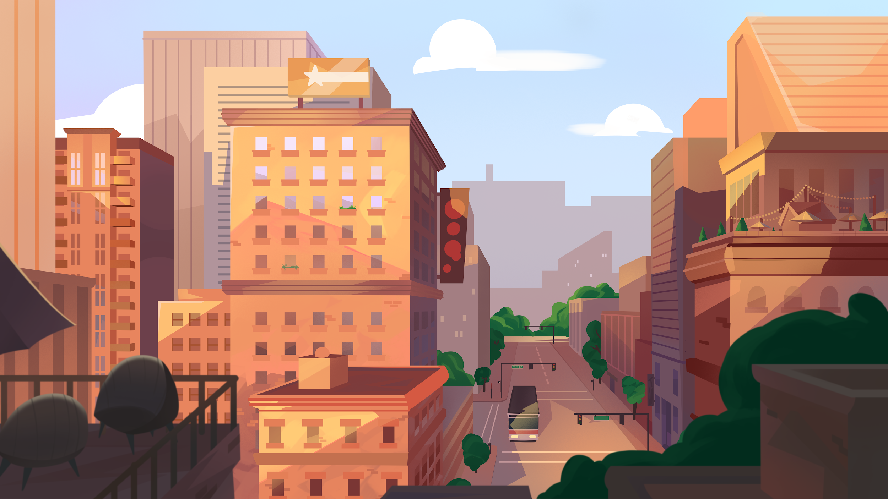
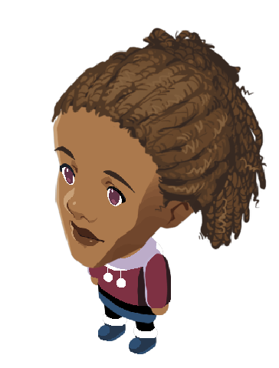
Tonya’s issue
Air pollution in cities across America is rising to dangerous levels, especially impacting people who are already sick. Who can help?
Tonya lives in a big city, or urban area. The main jobs are in tech companies, city government and tourism.
What is her issue?
Air pollution!
Notes:
Have students read Tonya’s issue and brainstorm who she can ask. She’s concerned about all cities, not just in her own, although her city is impacted so getting money from the government will help.
Ask students if they know who Tonya could contact to create a law limiting air pollution. (Her Representative in Congress.)

Slide 6
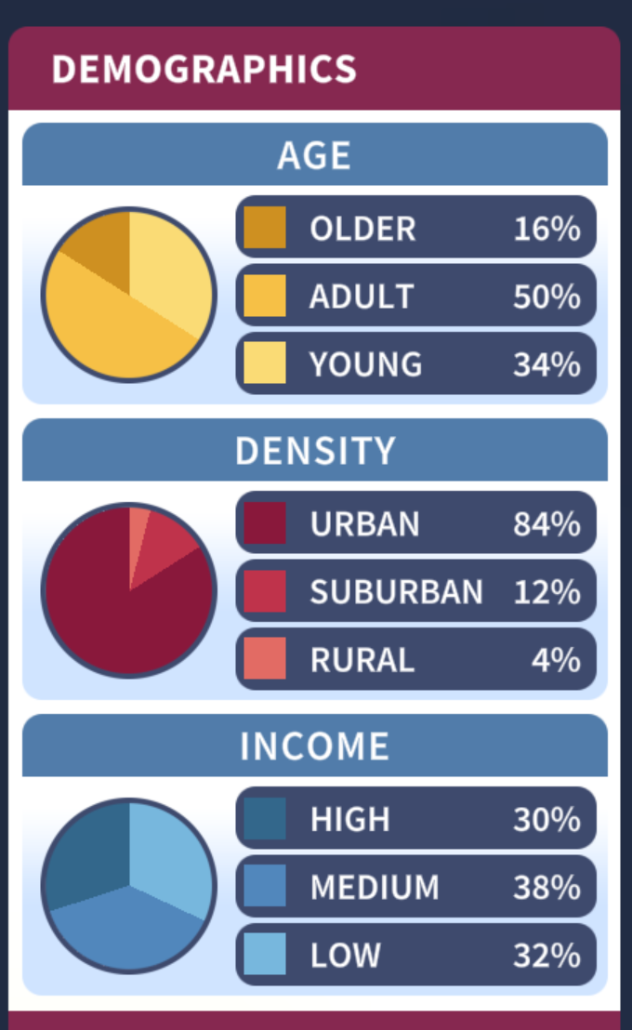
Districts & Demographics
Tonya’s district (area where she lives) is urban and diverse. Let’s look at the demographics from Tonya’s district and answer the questions.
Which group would be most likely to support a bill to limit air pollution?
Do you think it’s a popular issue in this district?
Should she write to her representative in Congress about it? Why?
demographics: qualities (such as age, gender, and income) of a specific group of people
Notes:
Explain that a district (n.) an area (or section) of a state, city, or town.
Read the questions and prompt the class to discuss.
Walk through the Demographics:
What age groups are most affected by air pollution? Who do you think would care about it the most? Perhaps adults and young people (add thing them up would be 84%)
Pollution is a major issue in the city and it it impacts people with compromised health. Most of the people in Tonya’s district live in the city, or urban spaces.
The income levels look pretty evenly spread between low, medium, and high income earners. Air pollution impacts all of these incomes.

Slide 7
U.S. Congress
The United States Congress, in Washington D.C., is the lawmaking branch of our government and it is bicameral (made up of two chambers).
The House of Representatives
Members work for the people in a specific section of their state called a district.
The Senate
Senators represent the needs of the entire state.
How can Tonya’s idea about limiting air pollution become a law?
Let’s find out!
Notes:
Point out that each chamber includes elected officials from all fifty states. Congress was created by the Constitution, and that document describes how this branch of government works. There are two senators from each state (100 total). The number of representatives (in the House) from each state depends on the population (435 total). Senators serve 6 year terms and representatives serve 2 year terms, but they can be re-elected.
In this game, the student will be playing the role of a member of the House of Representatives and will try to pass their bill in both chambers.

Slide 8
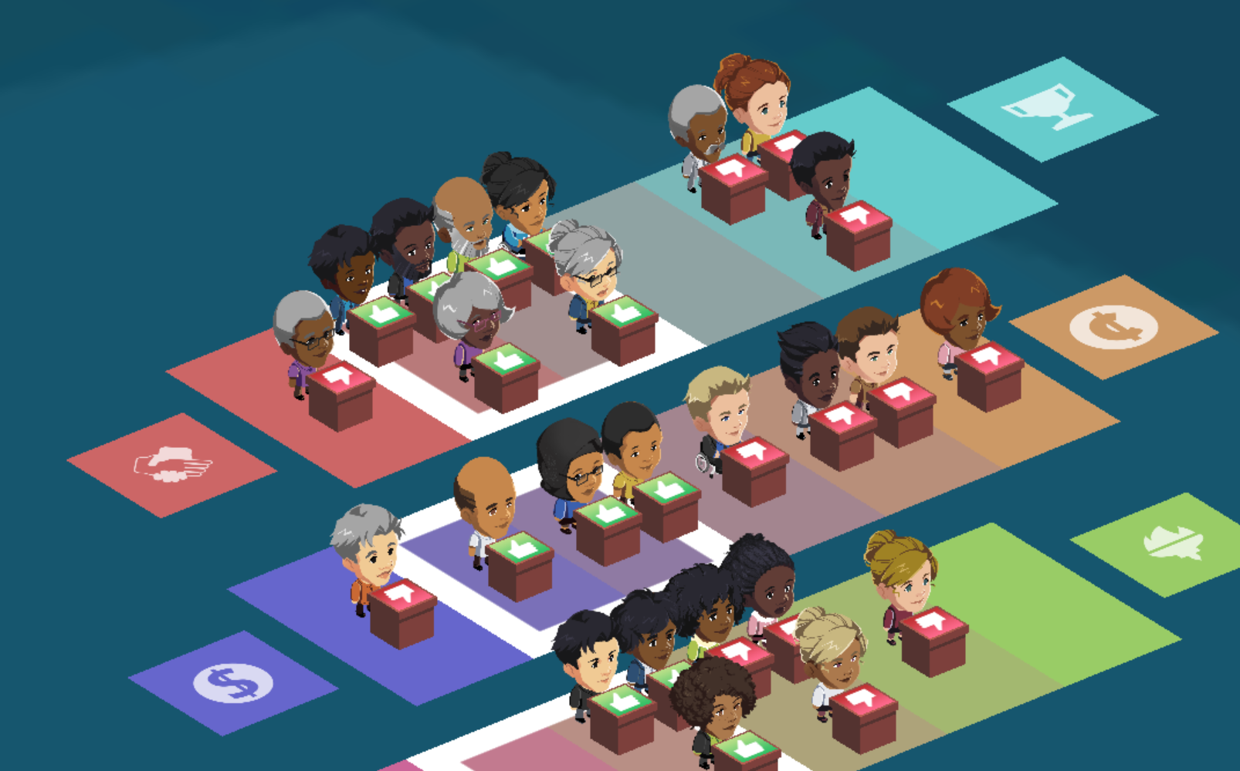
The Lawmaking Process
Mini Lesson

Slide 9
Let’s start with an idea...
Laws start as an idea. They represent something people in a certain district or area need.
The rough draft of a law is called a bill. Bills can start in either chamber of Congress.
idea
bill
law
But if all the representatives have different interests or needs, how do laws ever get made?
Through compromise!
Notes:
Ask: Where do ideas for laws come from? Have students brainstorm. Sample answers: Citizen letters & emails, challenges facing the nation, interest groups, research on the issues.
Explain that compromise in in Congress involves deliberation (discussion) along with adding and removing clauses to the bill which will be explained more in the next slide.

Slide 10
Crafting a Bill
Tonya’s representative introduced the idea. It became a bill.
But to get it passed in Congress, other ideas (or clauses) need to be added to that bill.
Why?
Because in order for a bill to become law, it has to pass the House and the Senate. So, it must meet the needs of people from different states.
Why?
By adding clauses, representatives can better represent their people. The more clauses, the more people are represented.
Notes:
Explain that in the game, students turn an idea into a new bill for the House of Representatives to work on. They then hold hearings in which they choose someone to share their thoughts on a bill. This will unlock additional clauses to use.
Hearings are held next. They invite people to share their thoughts on the bill.
Then they deliberate (discuss and decide) on which clauses to include to get the most support!
Point out that bills can go back and forth between both chambers before being sent to the house.

Slide 11
The lawmaking process...
Tonya’s representative received her letter and likes the idea!
STEP 1. The idea is introduced by the representative. It then becomes a bill.
STEP 2. Hearings are held to help Congress learn more about the issue.
STEP 3. Both houses of Congress deliberate on the contents of the bill.
STEP 4. Call for Vote: The bill must pass both chambers of Congress to go to the president.
STEP 5. The bill heads over to the white house for presidential review. If it is signed, it becomes a law. If it is vetoed, Congress can override it with a supermajority.
Notes:
This is a simplified version of the lawmaking process. LawCraft focuses on the the House of Representatives and the deliberation in Congress.
Bills can start in either chamber. In this game, they start in the House. Point out that for Step 5, if the President vetoes the bill, congress can override it with a supermajority (which is ⅔ of the vote).
ELL: go over the meaning of hearings, deliberate, vote, chamber, Congress, presidential review if needed.

Slide 12
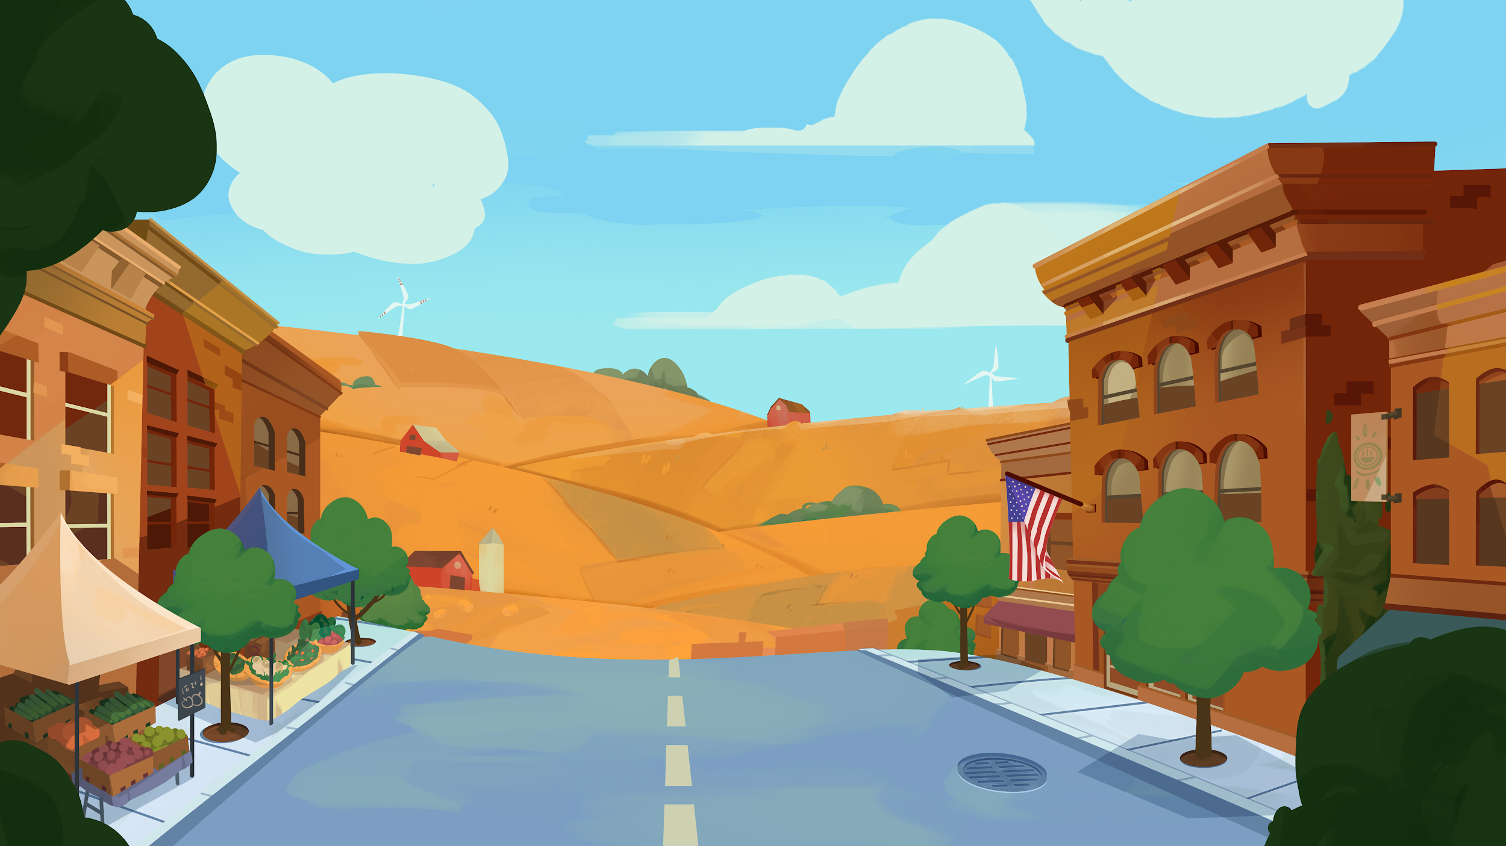
My LawCraft district
Fill in the chart with details about the district you chose as you play the game.
My district | Demographics | My bill
Brief description: | Age: Density: Income: | Topic: Will people in my district support my bill? Why or why not?
Notes:
There is a graphic organizer in the Extension Pack PDF that students can use to take notes as they play the game.
Note: there are two versions provided in the PDF. One is open-ended and the other has sentence starters. Provide ELL students with the appropriate version as needed.
For the demographics category, have students describe them in their own words (without pie charts or percentages). For example: Mostly older population. Mostly urban. Evenly split across income levels, etc.

Slide 13
Next...
Play in English
Jugar en español
OR
Want to make a law? Pick an issue take it all the way through the lawmaking process.
Notes:
Allow students to play in pairs or small groups. If possible, place them in mixed-ability groups. While advanced students can play by themselves, we recommend partner play for increased speaking and listening opportunities.
Encourage the use of the game’s reference materials for support – glossary, decision support tool, repeated voice over, etc. The game is available in Spanish, consider using translating tools in other languages as needed.

Slide 14
Represent Me!
Post-Game Activities

Slide 15
Lawmaking process
What are the steps that a bill takes before it becomes a law? Drag the correct terms to the blanks.
bill
Congress
deliberate
Hearings
idea
law
pass
signed
Vote
1. An _________ is introduced by the representative. It then becomes a _________.
2. _________ are held to help _________ learn more about the issue.
3. Both houses of Congress _________ or discuss the contents of the bill.
4. Call for _________: The bill must _________ both chambers of Congress to go to the president.
5. The bill heads over to the White House for presidential review. If it is _________ , it becomes a _________ .
Notes:
For number 4, the bill may go back and forth between both houses several times before it heads to the White House.
For number 5, remind students that if the bill is vetoed, Congress can override it with a supermajority vote. The the bill can become a law.
Expansion: Have students review the five steps and then summarize them orally without looking at their paper.
Act it out: Have students role play the process of a bill becoming a law. This can be done in groups with a representative presenting the idea, a few students to represent the House and deliberate there, a few students to represent the Senate and deliberate there. One person can be the president and can approve or veto the law. If it is vetoed, Congress can vote again.

Slide 16
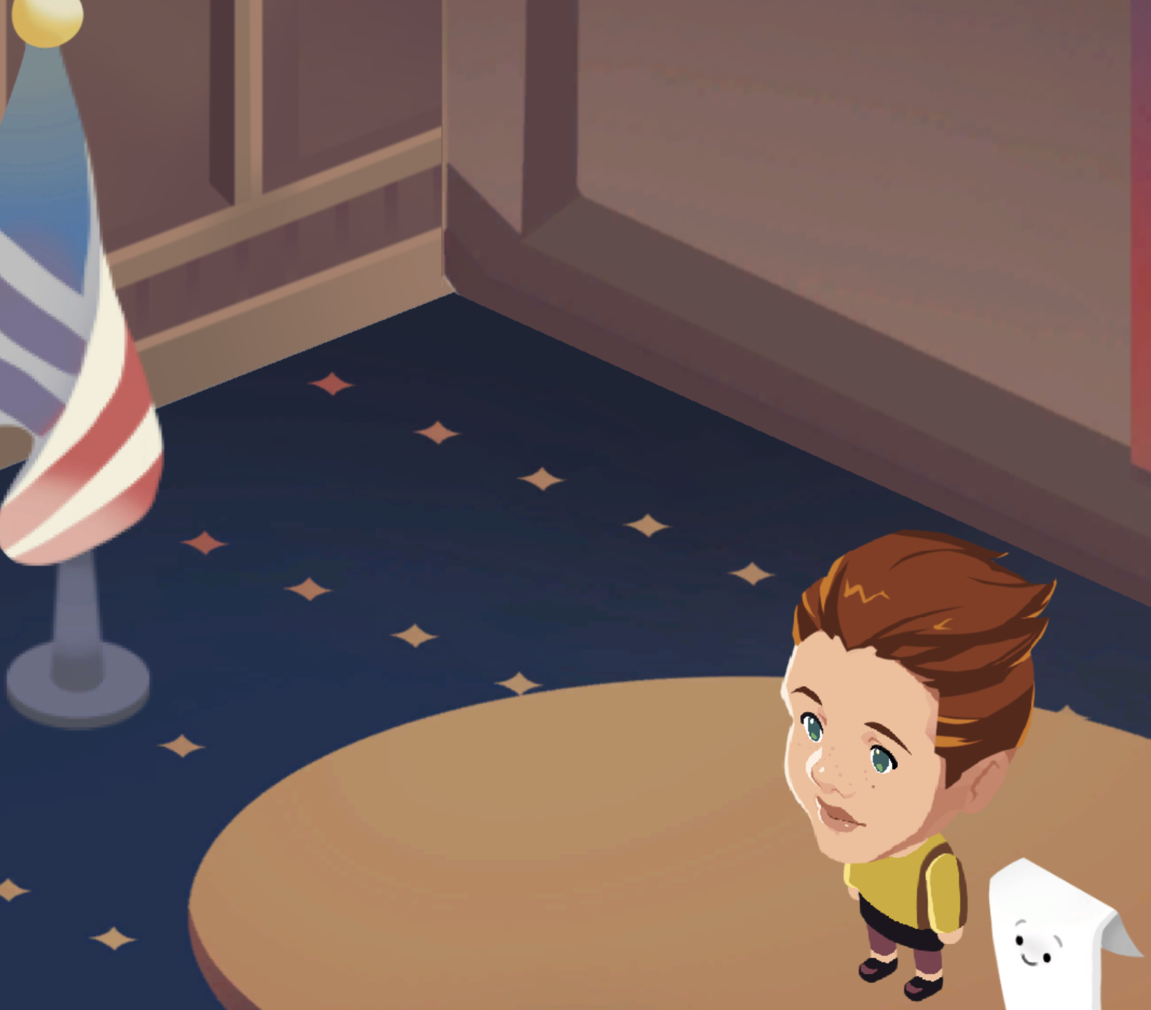
Hearings and Deliberation
1. People have different perspectives and views on the issues based on who they are and what they do. Would a teacher, a parent, and a governor have different thoughts on an education bill? Why or why not?
AIR AND WATER QUALITY:
Our health and safety depend on access to safe air to breathe and clean water to drink.
2. Imagine you are introducing a bill on Air and Water Quality.
Who would you want to give testimony? Who can teach your colleagues the most about this issue?
Rank the people who could speak on your bill from 1 (the least helpful) to 5 (the most helpful).
5
4
3
2
1
Allergy Sufferer | Department of Energy official | Famous Actor | Green Energy Activist | English Professor
Notes:
Ask the question about the education bill to get the ball rolling. Discuss it as a class. (Possible responses: A teacher would care because funding affects their class size, course materials, salary, and more. A student would care because it affects their daily life in school. A parent would care about their child’s education. A governor would care because they are in charge of the budget, plus their constituents would care about this issue. )
Then have students work in pairs or small groups to rank the people who could talk about the Air and Water quality bill.
EXPANSION: In small groups, have students create a piece of testimony about what that they would like to see happen with education or the climate in your town or district. This should be done orally (read to the group or the class). They can choose different roles (teacher, parent, student, green energy activist, etc.)

Slide 17
Discussion questions
1. Congress has two parts. What are they? What is the difference between them?
2. How did your constituents feel about your bill?
Were you surprised?
3. Why do you think the process involves adding and removing
so many clauses?
4. How is the lawmaking process affected by
different people’s values?
Notes:
Answers will vary.
First have students discuss each question in pairs. Tell them to use what they learned from the game and post game activities to help them. Then go over their responses as a class.
ELL: provide definitions of constituents, surprised, adding, removing, process, values as needed. Provide sentence starters such as: 1. The two parts in Congress are __________ and ____________. Members of the House of Representatives represent __________. Members of the senate represent _________. 2. My constituents (supported / did not support) my bill. I was (not) surprised because (reason). 3. I think the process adds and removes clauses in order to (reason). 4. The people’s values (such as equality, generosity, competition) are connected to (the clauses).
VARIATION: Have students answer the questions in writing.

Slide 18
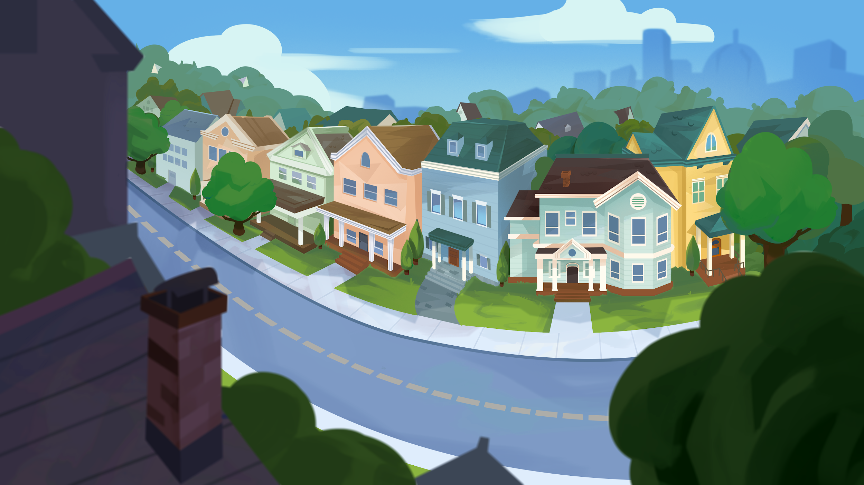
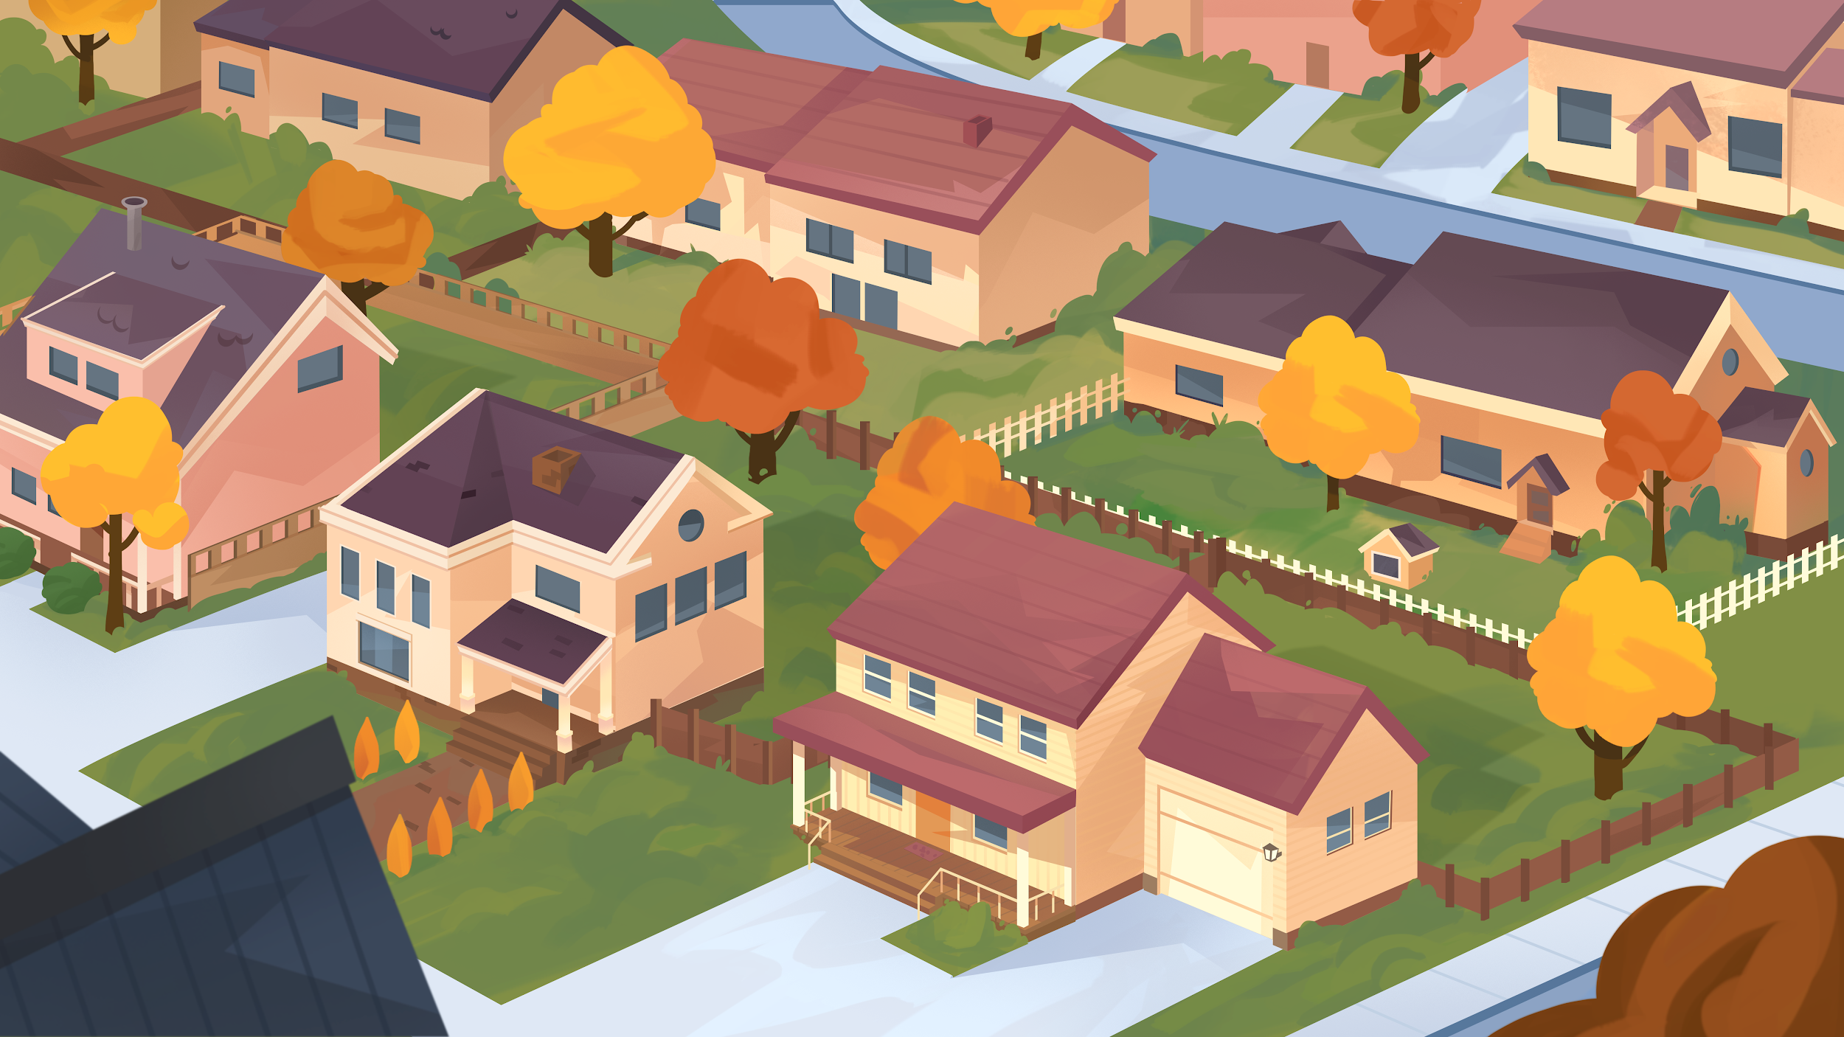
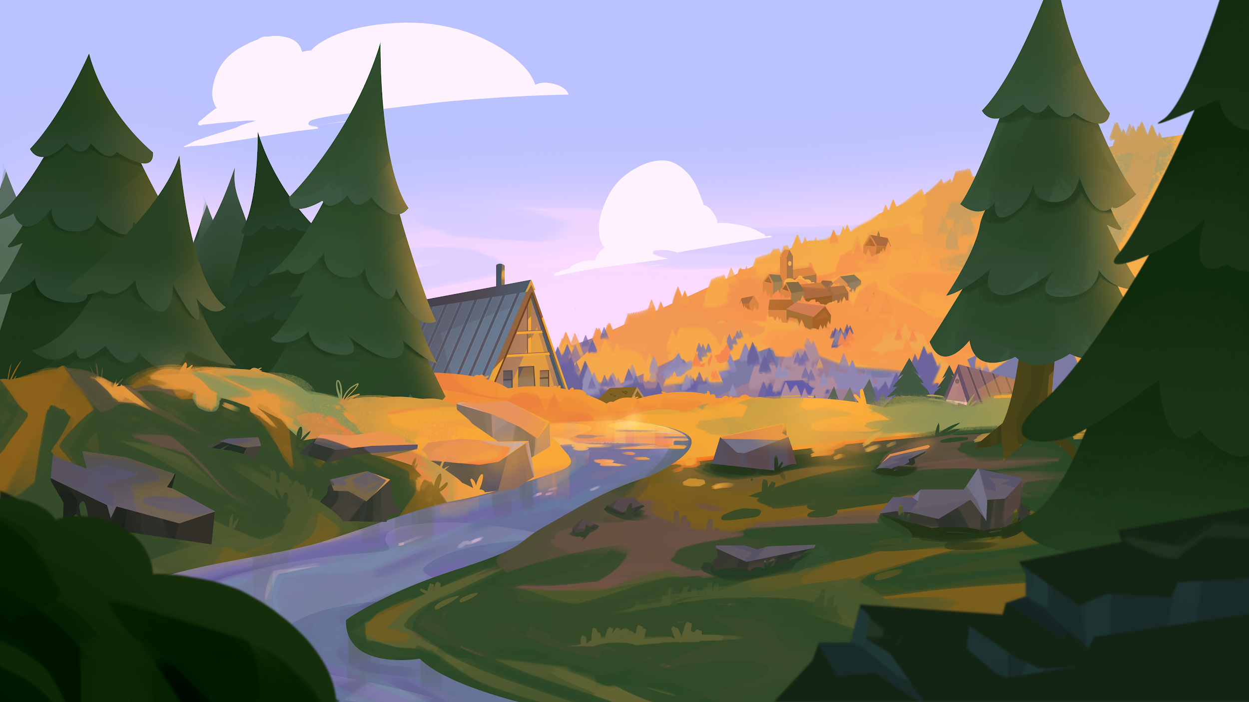
Know your district!
What does your home district look like? Create a fact sheet.
Include:
A description of your district
Demographics (pie charts! percentages!)
Who represents you in Congress
List a few bill ideas or topics that might interest your community based on the data.
Notes:
Have students go online and find information on their district and their representative.
They can write their answers using the organizers in the Extension Pack.
For #4, students can brainstorm topics, but you may want to give them a list of ideas to choose from.

Slide 19
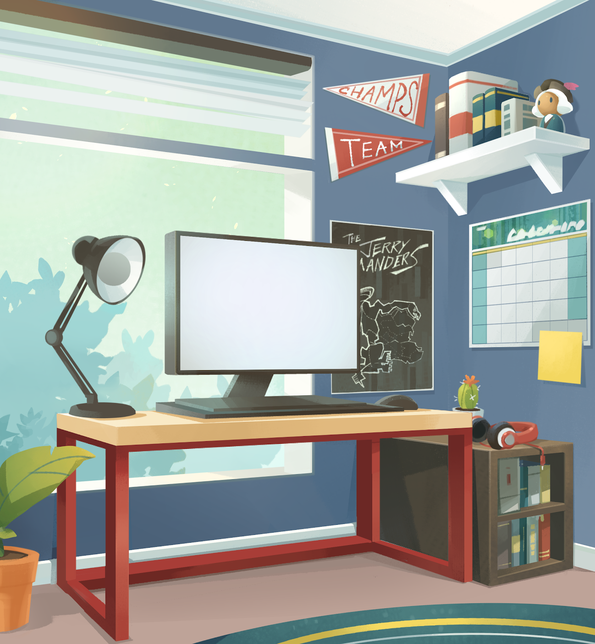
Write a message
Research your representative in the U.S. House of Representatives.
Choose an issue:
Education
The Environment
Healthcare
Social Services
Food Safety
Space Exploration
Write them a message about the issue.
Include your contact information and ask them to respond.
Notes:
Have students use the information about their Representative that they researched for Know your district!
Provide student with a list of issues they can choose from for their bill: School Support, Career Readiness, Air & Water Quality, Natural Resources, Medical Research, Healthcare, Space Exploration, Community Services, etc.
Have them write an email or letter (either individually or in pairs or groups) on an issue that is important to them. You may want to point out that people also use social media to contact their Reps as well.
Use an email script that all the students follow, but that also allows them to add a line or two stating why they think the issue is important.
EXPANSION: Have students send their letters to their representative and see if they get responses.

Slide 20
Mini-Quiz
Test Your Knowledge

Slide 21
1) Members of the House of Representatives represent...
A. entire states
B. a region with a number of states.
C. a district within a state
✓

Slide 22
2) Members of the Senate represent...
A. entire states
B. the whole country
C. a district within a state
✓

Slide 23
3) In order to become a law, a bill must pass:
A. Only the House
B. Only the Senate
C. Both the House and Senate
✓

Slide 24
4) Congress is made of two chambers, the Senate and House of Representatives. Another word for “two chambers” is ________.
bicameral

Slide 25
5) Members of the Congress represent the voters back home. These voters are called:
A. employees
B. constituents
C. supporters
✓

Slide 26
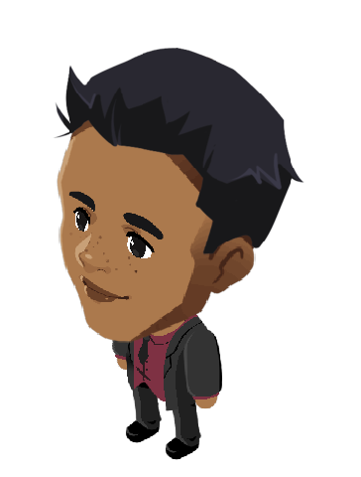
6) An area established by the government for representation and official government business is called a ______________ .
A. demographic
B. representative
C. district
✓

Slide 27
7) People speak about bills at ______________ in Congress.
hearings

Slide 28
8) What is the lowest percent of support a bill can receive and still pass the House or Senate?
A. 33%
B. 51%
C. 67%
✓

Slide 29
9) If the House and Senate version of a bill don’t agree, it is thrown in the trash.
A. True
B. False
✓

Slide 30
10) The President of the United States has the final say on whether a bill becomes a law.
A. True
B. False
✓

